Slide 1
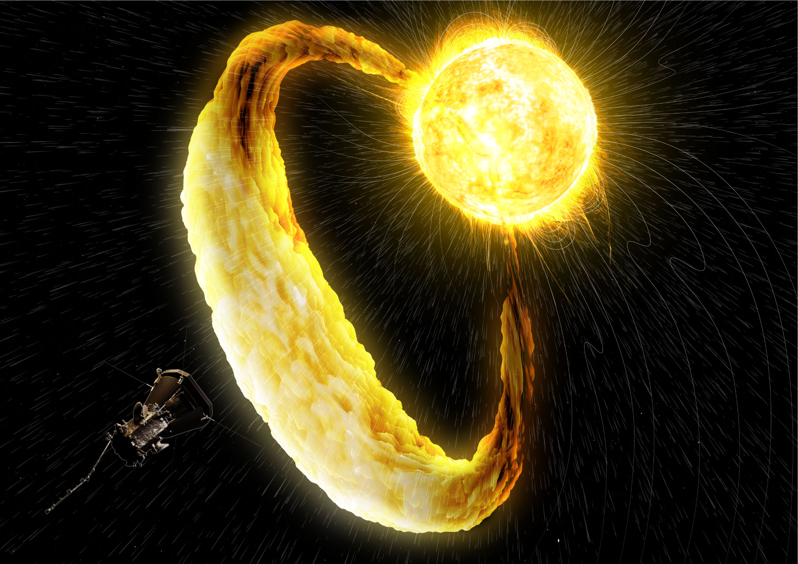


A statistical analysis of switchback data from the Parker Solar Probe can verify their wind-accelerating properties.
Riddhi Bandyopadhyay, PhD, Princeton University, Dept. of Astrophysics
Juston Ward, Sam Houston State University, Physics ‘24
Credit: NASA/Johns Hopkins APL/Ben Smith

Slide 2
My references will be here for the presentation.

Slide 3
Where the magnetic field suddenly changes direction, the solar wind sees sudden rapid increases in velocity.
Radial velocities invert.
Transverse velocities increase magnitude.
Switchbacks may be drivers of the solar wind.
Even at significant distance from solar surface, they may accelerate the wind.

Slide 4
Switchbacks can form through surface processes.
Coronal holes are sources of the solar wind.
Footpoint motion leads to the switchbacks.
As the sun and its surface rotate, the coronal holes and magnetic line footpoints move at different rates.
As the footpoints cross from slow wind sources to fast wind sources, the magnetic field lines become distorted.

Slide 5
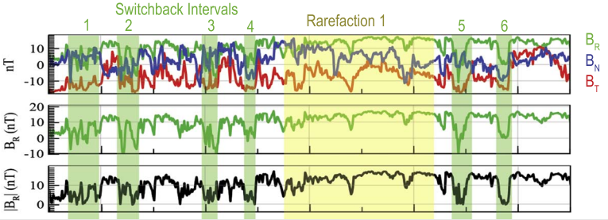
My first task is to replicate the plots from Schwadron/McComas (2021).
This will introduce me to the relevant data and variables.
This will ensure that I understand the data that I will analyze.
This will challenge and strengthen my numerical analysis and coding skills.

Slide 6
Q: Why do we expect transverse velocity to be higher in switchbacks?
A: The solar wind propagates transversely to the Alfven waves. In the switchbacks, magnetic field lines reverse, radial velocity inverts, and the poynting vector of the affected waves indicates the direction of wind acceleration.

Slide 7
The goal for this project is to compare V_{T} within and outside of the switchbacks systematically.
I must finish replicating the published plots.
I will learn to separate signal from background.
I will gather statistics and construct histograms.
I will ask LOTS of questions.
Thank you

Slide 8
